Slide 1
Web Design with HTML and CSS
Day 3

Slide 2
Using Cascading Style Sheets
Style – It is a rule that defines the appearance of an element on a webpage
Style sheet – It is the set of CSS style rules
Style sheets provide a means to separate style from content because it gives the flexibility to redesign or rebrand a website
A single CSS style sheet file containing the defined styles can be attached to several webpages to apply the styles to all the attached pages

Slide 3
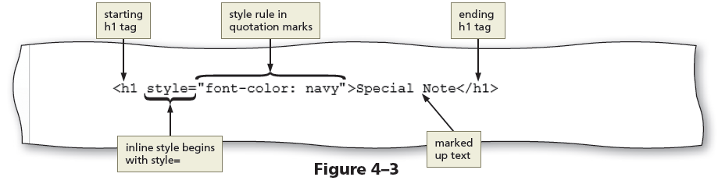
Inline Styles
Inline style – It is used to add a style to the start tag for an element, such as a heading or paragraph, using the style attribute

Slide 4
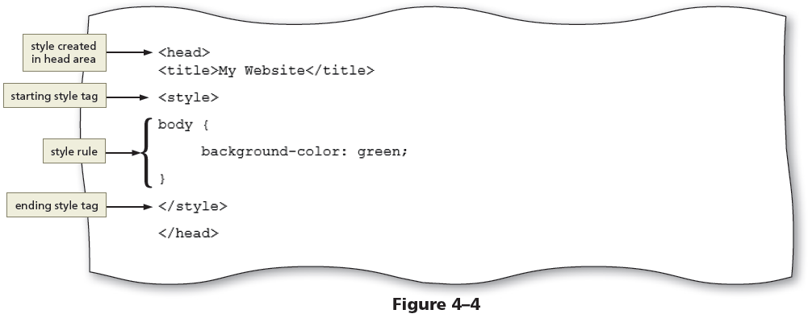
Embedded Style Sheets
An embedded style sheet, also called an internal style sheet, includes the style sheet within the opening <head> and closing </head> tags of the HTML document

Slide 5
External Style Sheets
An external style sheet – It is a CSS file that contains all of the styles that can be applied to more than one page in a website
External style sheets are also called linked style sheets
An external style sheet is a text file with the .css extension
To apply an external style sheet, link it (or attach it) to a webpage using a link in the head section of the webpage

Slide 6
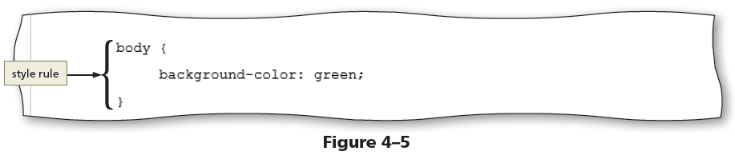
External Style Sheets (continued)
External style sheet provides flexibility to quickly change webpage formats because the styles used in it are applied to every page linked to it
Changing the look of an entire website is sometimes called reskinning the website

Slide 7
Style Sheet Precedence
Style sheets are said to “cascade” because each type of style has a specified level of precedence (or priority) in relationship to the others
CSS properties can be inherited from a parent element through a principle called inheritance
If a selector has more than one CSS rule, specificity determines which CSS rule to apply

Slide 8
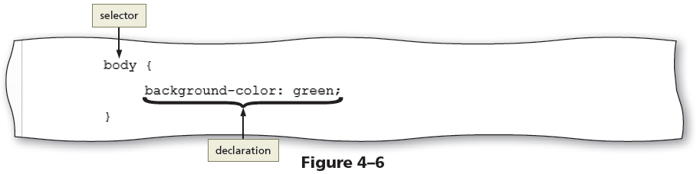
CSS Basics
Each CSS rule consists of a selector and a declaration

Slide 9
CSS Basics
A declaration consists of a property and a value, separated by a colon and followed by a semicolon
The property identifies the style quality or characteristic to apply, such as
color (text color)
background-color
text-indent
border-width
font-style
For each property, the declaration includes a related value that identifies the particular property value to apply
Selector – It is the part of the statement that identifies what to style
Any HTML5 element such as body, header, nav, main, or footer may be a selector
A selector may also be the value of an id or class attribute
The declaration defines the exact formatting of the style

Slide 10
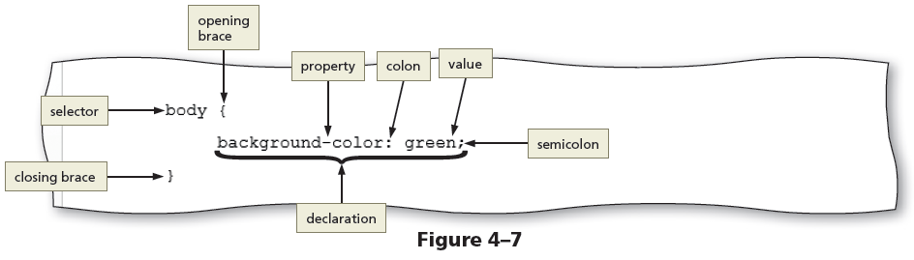
CSS Basics

Slide 11
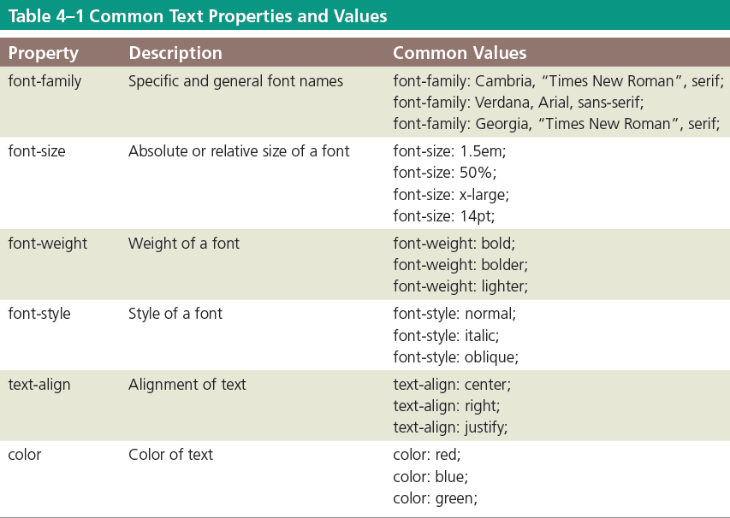
CSS Text Properties

Slide 12
CSS Text Properties
Fallback values – They are the additional values provided for the font-family property in case the browser does not support the primary font
CSS measures font sizes using many measurement units, including pixels, points, and ems, and by keyword or percentage

Slide 13
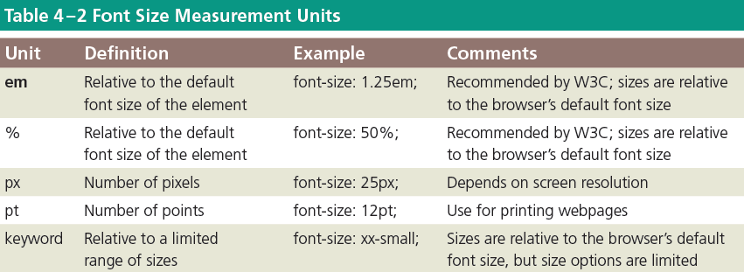
CSS Text Properties

Slide 14

CSS Colors
HTML uses color names or codes to designate color values
Two types of color codes can be used with CSS:
Hexadecimal
RGB
Hexadecimal values consist of a six-digit number code that corresponds to RGB (Red, Green, Blue) color values
http://www.eos.ncsu.edu/e115/text.php?ch=10&p=hex

Slide 15
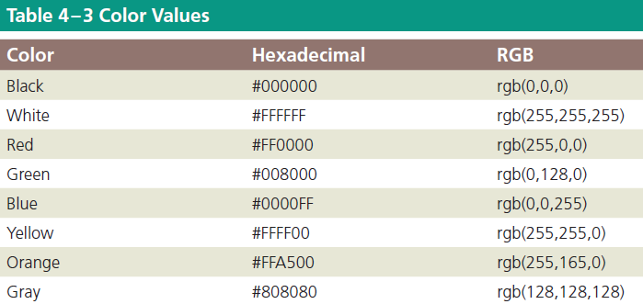
CSS Colors
To use a color in a style rule declaration, use the color value as the property value
For example, to style a background color as gray use, background-color: #808080;
Tip: use the color picker tool to select a web color: http://www.colorpicker.com

Slide 16
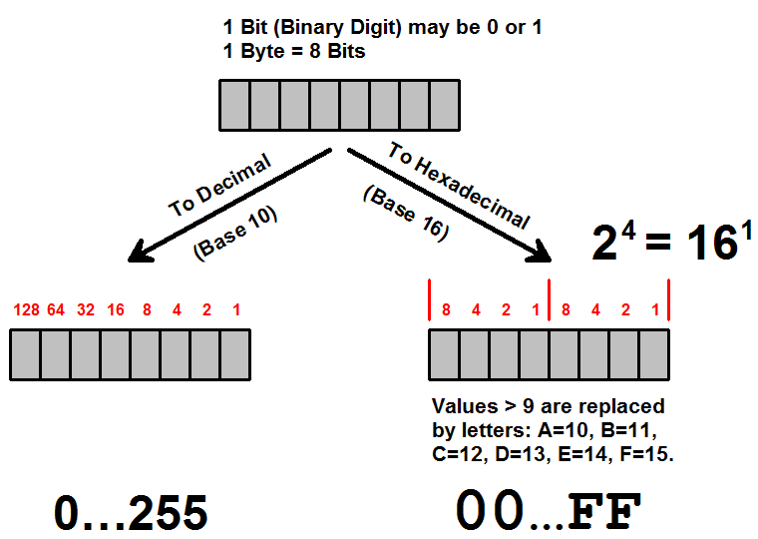
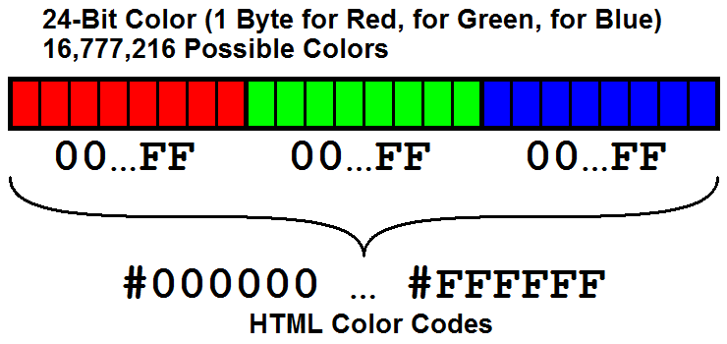
Hexadecimal System
Colors are represented in hexadecimal format as three bytes: one byte for red, one for green, and another for blue. A byte (8 bits, coined by Werner Buchholz) can have a value between 0 and 255. Rather than specifying them as a triple of decimal numbers, each byte can be conveniently represented exactly as two hexadecimal digits.
Hexadecimal, or hex, is, like decimal and binary, a positional number system; however hex digits are base 16. They are written using 0-9 for the first 10 numerals, and A-F for the remaining 6 numerals. Decimal 10 becomes hexadecimal A, 12 becomes B, etc., up to F. The values 0 through 255 become 0 through FF.
Computers uses hex to specify colors. They begin with a hash followed by six hex digits. The first two hex digits represent the red intensity, the next two represent green, and the last two represent blue: #rrggbb. For example, a bright red color can be thought of as full red intensity with zero intensity green and blue, thus #FF0000. When red and green light are mixed, the result, #FFFF00, is yellow.
http://people.cs.umass.edu/~verts/cmpsci120/cmpsci120.html

Slide 17
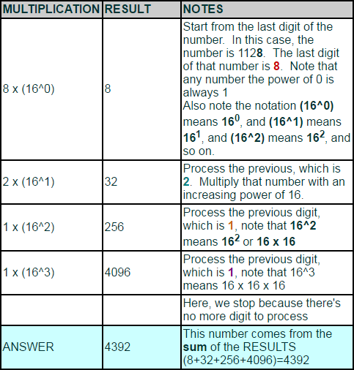
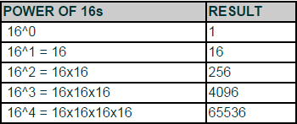
Converting Hex to Decimal
Convert 1128 to Decimal
If you want to be a speed counter, it's beneficial to memorize the values of the smaller power of 16s, such as in this table

Slide 18
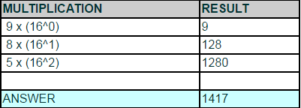
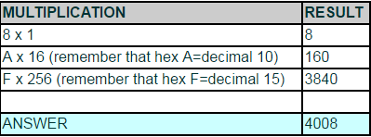
Converting Hex to Decimal
Convert the number 589
HEXADECIMAL to DECIMAL
If you want to be a speed counter, it's beneficial to memorize the values of the smaller power of 16s, such as in this table
Convert the number FA8
HEXADECIMAL to HEXADECIMAL

Slide 19
Exercises
230
Convert E6 to decimal equivalent;
Convert A2 to decimal equivalent;
Convert 2 to hex equivalent;
Convert 255 to hex equivalent;
Convert 200 to hex equivalent;
162
02
FF
C8

Slide 20
Understanding Inline Elements and Block Elements
HTML elements are positioned on the webpage as a block or as inline content
A block element appears as a block because it starts and ends with a new line, such as the main element or a paragraph element
Inline elements are displayed without line breaks so they flow within the same line
Inline content always appears within block elements

Slide 21
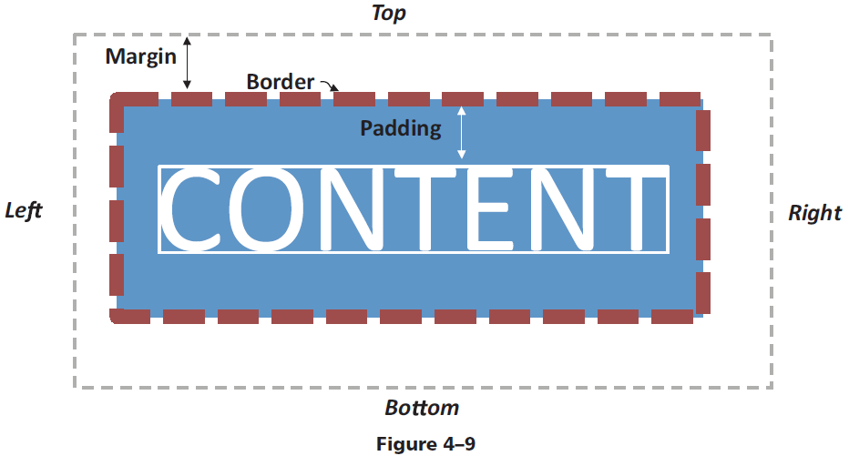
CSS Box Model
Each block element such as a header, nav, main, and footer element is displayed in a browser as a box with content
The CSS box model describes content boxes on a webpage

Slide 22
CSS Box Model (continued)
Each content box can have margins, borders, and padding
The margin provides passive white space between block elements or between the top or bottom of a webpage
The border separates the padding and the margin of the block element
Padding is the passive white space between the content and the border of a block element

Slide 23
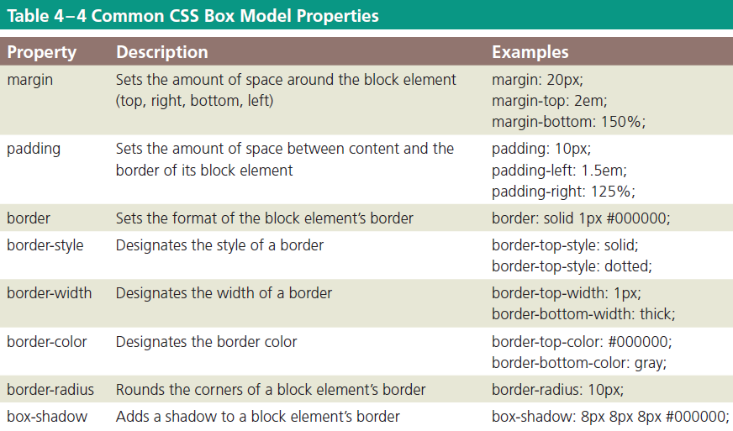
CSS Box Model

Slide 24
Selectors
A style rule begins with a selector, which specifies the element to style
A selector can be
an HTML element name
an id attribute value
a class attribute value
An id or a class selector is used to apply styles to p elements

Slide 25
Selectors
An id selector uses the id attribute value of an HTML element to select a single element
For example, to style the div id="container" element, use #container as the selector
#container {
border: solid 2px;
}

Slide 26
Selectors
A class selector is used to select elements that include a certain class attribute
For example, to style class="mobile", use .mobile as the selector
.mobile {
font-size: 10pt;
}

Slide 27
Selectors
A descendant selector is used to create style that applies to an element contained within another element
For example, the following style rule sets the list-style property to none for list items in an unordered list included in the navigation area:
nav ul li {
list-style: none;
}

Slide 28
To Create a CSS File and a Style Rule for the Body Element
In Notepad ++, click FILE on the menu bar and then click NEW to open a new document.
Click FILE again and then click SAVE AS
Navigate to the root “Fitness” folder and then double click on the “CSS” folder to open it.
In the file name box, type “styles.css” to name the file

Slide 29
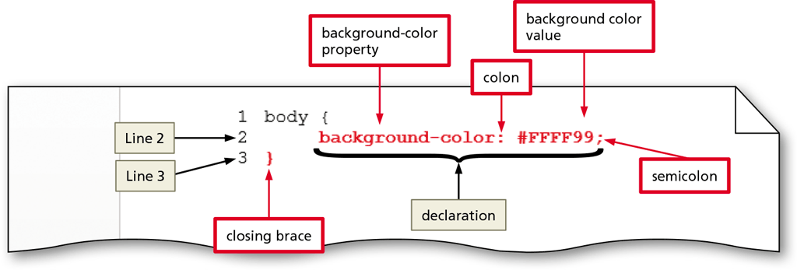
To Create a CSS File and a Style Rule for the Body Element
On Line 1 of the new document, type “body” as the selector
Press space and then type an opening curly brace
Press ENTER to add Line 2, then TAB to indent the new line, add the declaration for a background-color property and value as shown. Then add the closing brace on Line 3.

Slide 30
Linking an HTML Document to a CSS File
After creating a CSS file, link it to all the webpages that will use its styles
Insert a link element on the HTML page within the <head> and </head> tags
The link element uses two attributes:
rel
href
The rel attribute uses the stylesheet value to indicate that the document is linked to a style sheet
The href attribute value specifies the file path or file name of the CSS file
Following is an example of a link to a style sheet named styles.css and stored in the css folder:
<link rel="stylesheet" href="css/styles.css">
The type="text/css" attribute and value is also commonly used within a link element to reference a CSS file

Slide 31
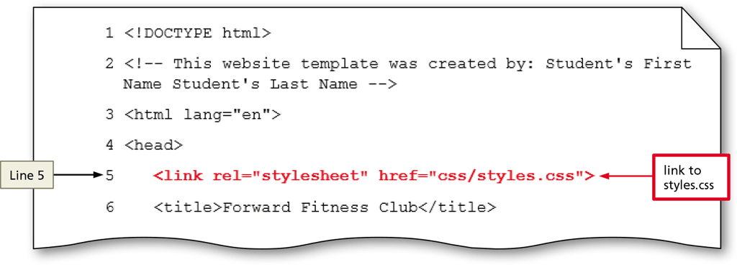
To Link the HTML Pages to the CSS File
Open “index.html” from the root folder
Place the insertion point after the beginning <head> tag on Line 4 and press ENTER to create a new Line 5
Press TAB to indent and enter the link

Slide 32
To Link the HTML Pages to the CSS File
Since all of our HTML pages will link to this same CSS file, we can COPY the text on Line 5.
Go to our other HTML files: “fitness.html”, “about.html”, and “contact.html” and PASTE the link on Line 5.
Check our active links in the browser to see how the color change has effected the <body> element of ALL our pages.
Again, normally we would link on the template file and then all other pages would be created from that file

Slide 33
Aligning Webpage Content
One way to align webpage content is to use the text-align property, which applies to block elements
The text-align property can use left (the default), center, right, or justify as its value
For example, the following rule centers an h1 element:
h1 {
text-align: center;
}

Slide 34
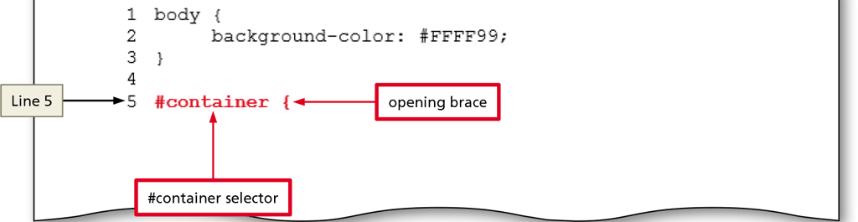
To Center Content
Return to the “styles.css” file
Place the insertion point after the closing brace on Line 3 and press ENTER twice to create new Lines 4 & 5
On Line 5, type “#container” and an opening curly brace. (use “#” since the container element was an ID value.)

Slide 35
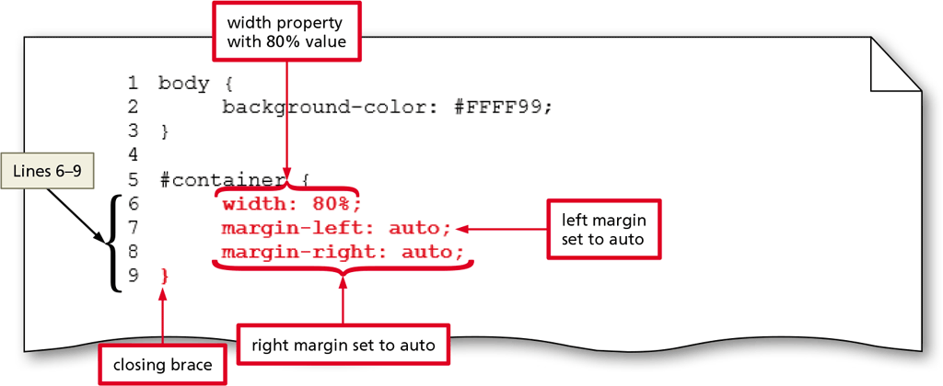
To Center Content
Press ENTER to add Line 6 and then TAB to indent the line.
Add the CSS data as shown

Slide 36
Creating Style Rules for Structural Elements
The header section appears at the top of a webpage and thus needs formatting that makes the header contents stand out and attract visitors to the page
The nav section should be formatted differently from the other structural elements as it should be prominent and easy to find on the webpage
The main section should be formatted using the display property

Slide 37
Creating Style Rules for Structural Elements
To apply text and box model properties to the main section and have them appear as intended, the display property is used
Create a style rule that formats the footer section by defining the font size, text alignment, and top margin of the footer element

Slide 38
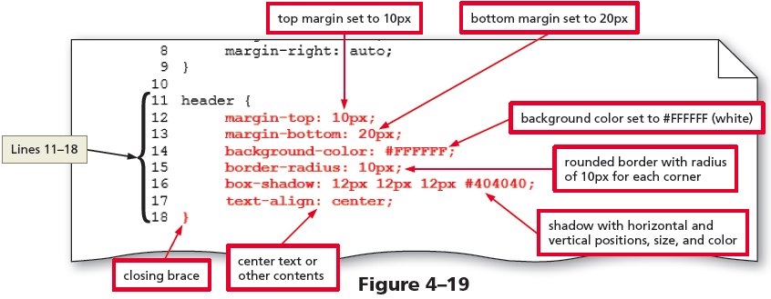
To Create a Style Rule for the Header Element

Slide 39
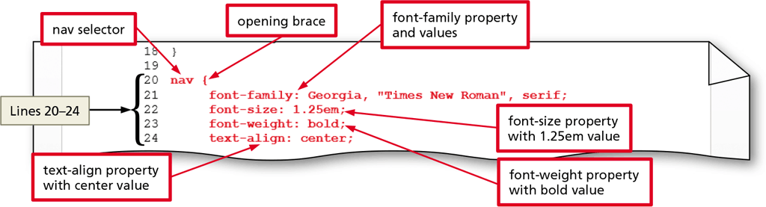
To Create a Style Rule for the Nav Element

Slide 40
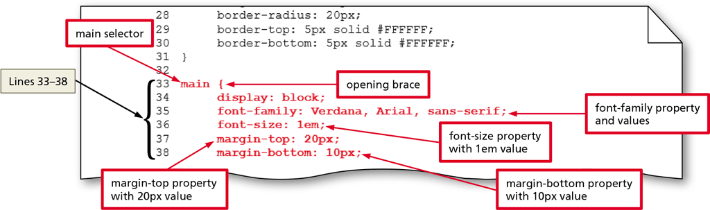
To Create a Style Rule for the Main Element

Slide 41
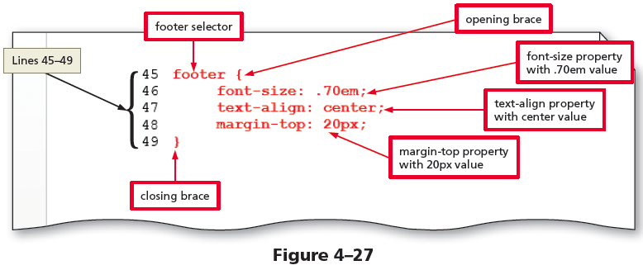
To Create a Style Rule for the Footer Element

Slide 42
Creating Style Rules for Classes
Consider the following example:
<img class="equip" src="images/equipment1.jpg" alt="Weight Equipment" height="195" width="260">
The img element displays the equipment1.jpg image
The first attribute and value, class="equip", assigns this element to the equip class
Including the class="equip" attribute and value in each img element helps format all the elements assigned to the equip class with a single style rule

Slide 43
Creating Style Rules for Classes
For example, the following style rule adds 20 pixels of padding to the right side of elements in the equip class:
.equip {
padding-right: 20px;
}

Slide 44
Creating Style Rules for Classes
To indicate a class name as a selector, include a period (.) before the class name
Float property – It positions an element to the right or left of other elements
Clear property – It removes the float effect from a webpage

Slide 45
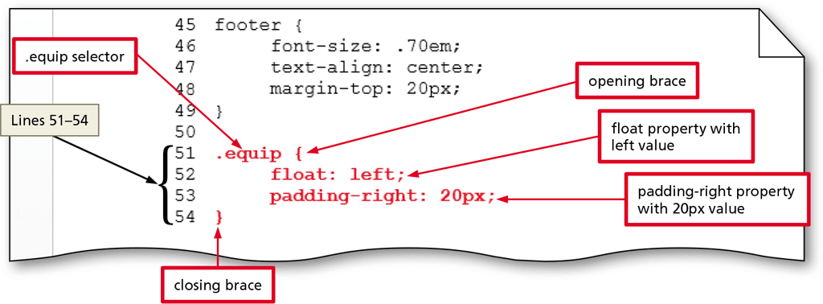
To Create a Style Rule for the Equip Class
Place the insertion point after the closing brace on Line 49 and press ENTER twice to create Lines 50 and 51.
Type “.equip” as the selector (remember, all images were set using the CLASS name “equip”)

Slide 46
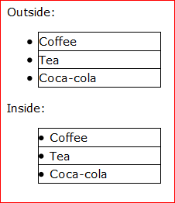
Using CSS List Properties
The CSS list-style properties are used to control the appearance of numbered and bulleted lists
Lists marked with the <ul> and </ul> tags display a solid bullet before each list item
Lists marked with the <ol> and </ol> tags display Arabic numerals (1, 2, 3, and so on) before the list items
For example,
ul {
list-style-type: square;
}
The default value for the list-style-position property is outside, which displays the list item with a bullet or number outside of the list’s content block.
Using inside as the value displays the bullet or number inside the list’s content block.
http://www.w3schools.com/cssref/pr_list-style-position.asp

Slide 47
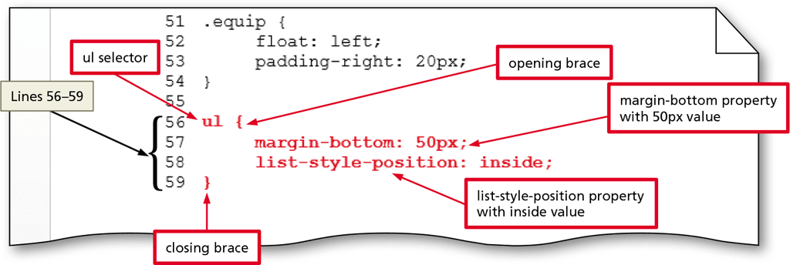
To Create Styles for List Elements

Slide 48
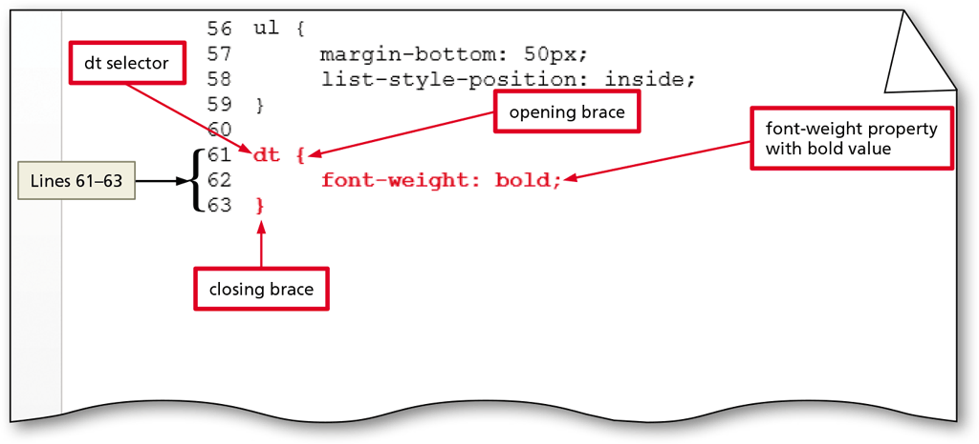
To Create Styles for List Elements

Slide 49
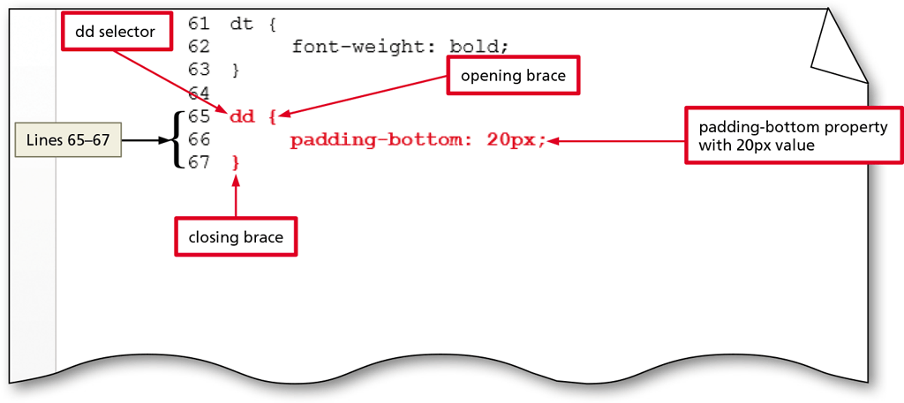
To Create Styles for List Elements

Slide 50
Adding Comments to CSS Files
Comments provide additional information about the area where the styles are applied or other helpful explanations, such as what the styles do
The syntax for a comment is as follows:
/* Place your comment here */

Slide 51
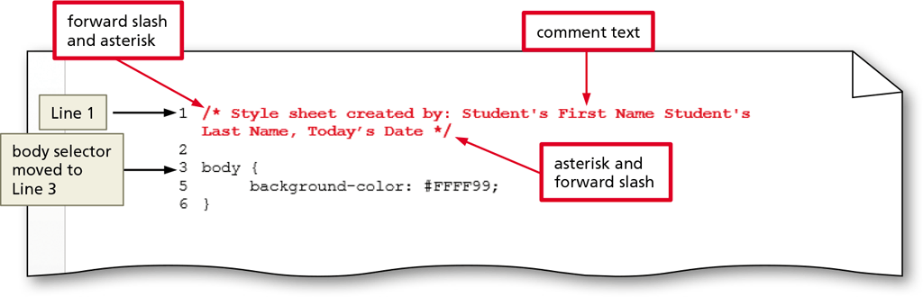
Adding Comments to CSS Files
Place the insertion point before the body selector on Line1, press ENTER twice to move the body selector down to Line 3.
Click back onto Line 1 and enter the CSS comment:

Slide 52
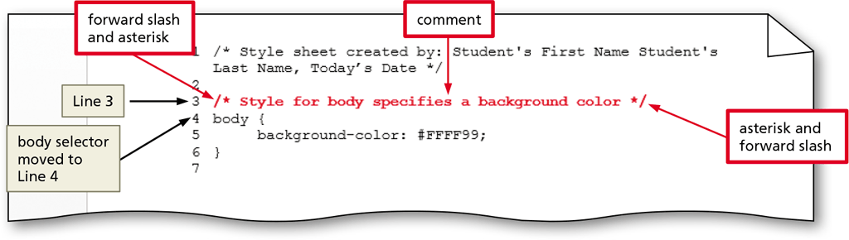
Adding Comments to CSS Files
Place the insertion point before the body selector on Line 3, press ENTER to move the body selector down to Line 4.
Click back onto Line 3 and enter the CSS comment:

Slide 53
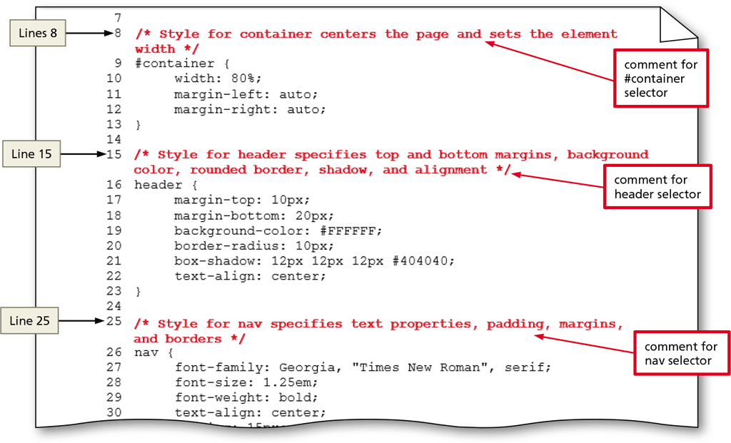
Adding Comments to CSS Files

Slide 54
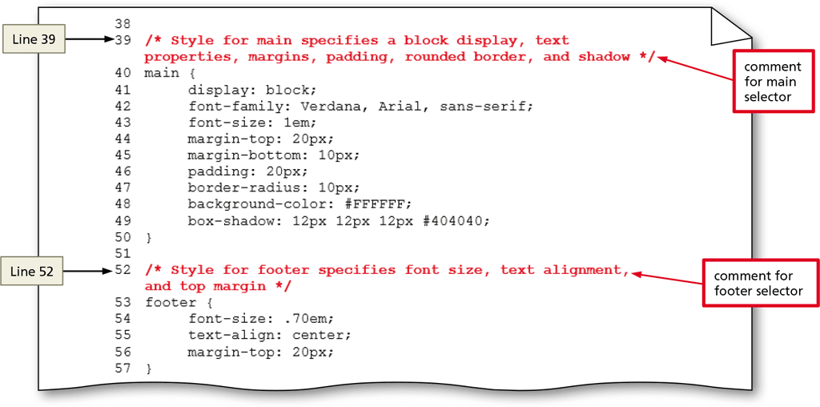
Adding Comments to CSS Files

Slide 55
To Validate the CSS File
The following steps validate a CSS file
Open the browser and type http://jigsaw.w3.org/css-validator/ in the address bar to display the W3C CSS Validation Service page
Tap or click the By file upload tab to display the Validate by file upload information
Tap or click the Browse button to display the Choose File to Upload dialog box
Navigate to your css folder to find the styles.css file (Figure 4–41)

Slide 56
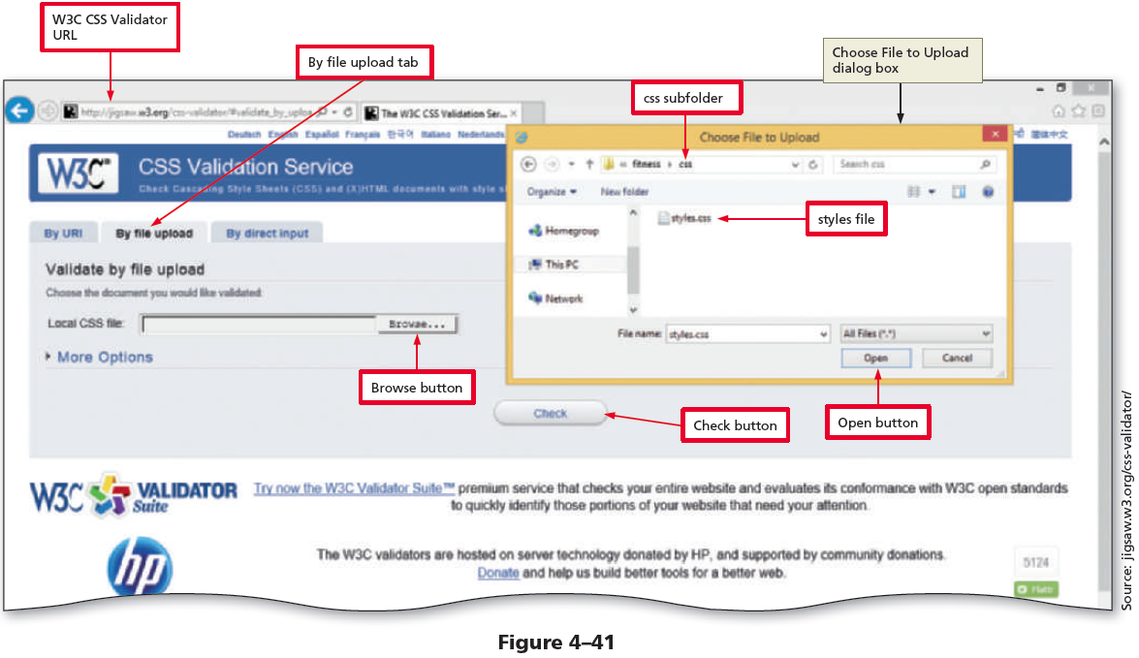
To Validate the CSS File (continued)

Slide 57
To Validate the CSS File
Tap or click the styles.css document to select it
Tap or click the Open button to upload the selected file to the W3C CSS validator
Tap or click the Check button to send the document through the validator and display the validation results page (Figure 4–42)

Slide 58
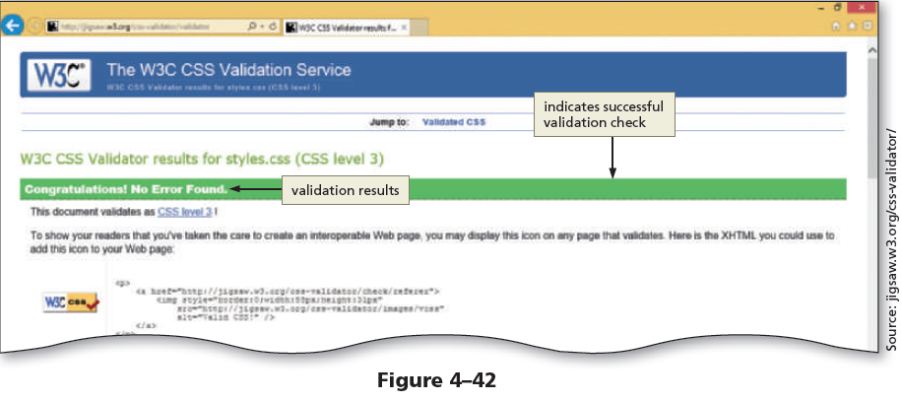
To Validate the CSS File

